Slide 1
The Deposition Process

Slide 2
Purpose of Deposition
Deposition places conductive or insulating layers on a substrate
Deposition processes create locally conductive paths that can be used to interconnect devices
Deposition can be used to build up more complex structures one layer at a time
Notes:
In the development of integrated circuits, deposition is used to create the interconnecting paths between the transistors and other components in the device. By using multiple steps of deposition, lithography, and etch, unique profiles can be built on a substrate. Structural details for MEMS, gratings, and other mechanical features are created by deposition of metallic species.

Slide 3
Deposition Types
Silicon Dioxide SiO₂
  Insulating layers
  Protective coatings
  Gate oxides
Silicon Nitrides
  Protective layers
  Isolation
Notes:
Silicon dioxide is one of the commonest depositions used in the manufacture of integrated circuits. Silicon is highly reactive with oxygen, and SiO2 coatings can be deposited through a number of processes, each of which has its own properties. Silicon Nitrides are hard coatings that are used to protect devices that have been fabricated.

Slide 4
Deposition Types
Polysilicon
  Heavily doped silicon
  Conductive
  Used for interconnects and gate
Metals
  Aluminum/Aluminum-Copper
  Tungsten
  Titanium Alloys
Notes:
Polysilicon is a heavily doped form of silicon that is conductive due to its doping level. It is used for gate interconnections in semiconductors. Since polysilicon is a “glass – like” compound, it has a much higher melting point than metals commonly used in the top-down process. This can be an advantage in the manufacturing process since the temperatures at which some processing steps occur are above the melting point of metals used.
Metals provide low resistance paths for signal and power on a device. Although polysilicon is conductive, it is nowhere near as conductive as most metals. Recent trends in semiconductor manufacturing utilize copper in place of aluminum as it is more conductive than aluminum. This makes it possible to have copper traces that are thinner than aluminum for the same current handling capabilities, allowing for denser wiring. Copper must, however, be isolated from other parts of the device to avoid migration problems. Tungsten provides a method to perform interconnections between layers. Titanium alloys are used to reduce barrier potentials that may exist between layers.

Slide 5
Deposition Processes
Physical or Chemical (or both?)
  Physical Processes Deposit the material without chemical reactions
  Chemical processes utilize liquid or vapor forms of precursors that react with the surface to form the desired deposition
  It is possible to combine the processes and gain the benefits of each
  Many processes are carried out in reduced pressure (partial vacuum) environments
Notes:
In general, deposition processes can be broadly characterized as either physical or chemical in nature. Physical processes deposit a layer of the species of interest onto a substrate without chemical reactions. A layering process that leaves atoms of the species on the surface takes place. Chemical processes can be “wet” or “dry” depending on the species and the ease at which it will be uniformly deposited at the desired thickness. In both physical and chemical deposition, there are processes that take place in low pressure (partial vacuum) environments. It is vitally important in deposition processes that the thickness of the layer be controllable as this can drastically affect the performance of the final device.

Slide 6
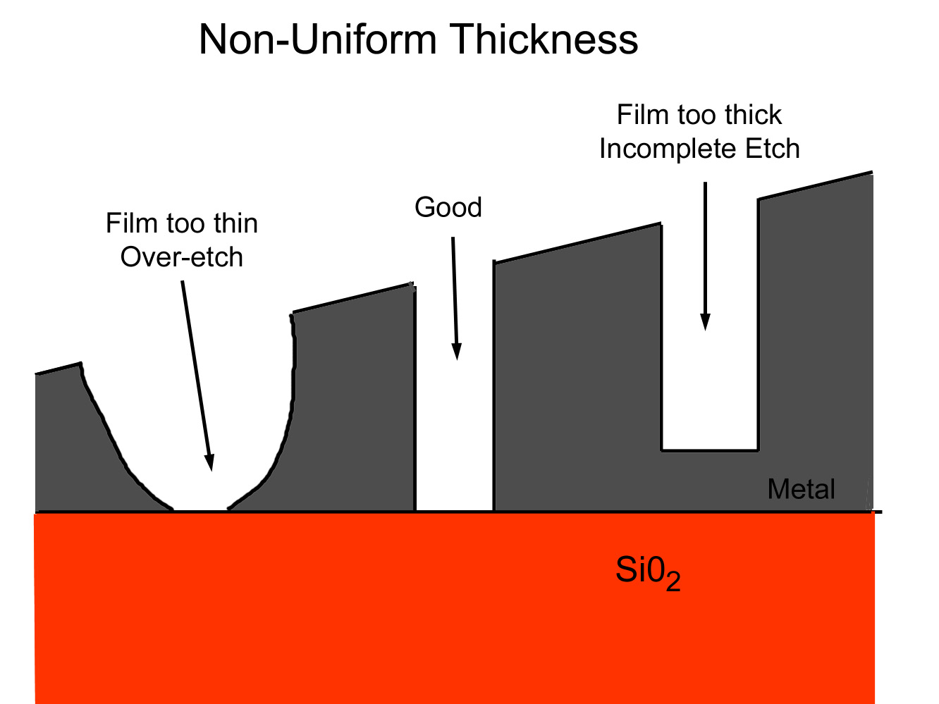
Result of Non-Uniform Deposition
From MATEC Module 61
Notes:
The result of a non-uniform deposition following photolithography and etching is shown above. The metal deposition which was intended to have a tall, narrow profile with a gap is over-etched at the right, leaving rounded edges and thin upper walls and under etched at the left, resulting in a short circuit. This device would be defective.

Slide 7
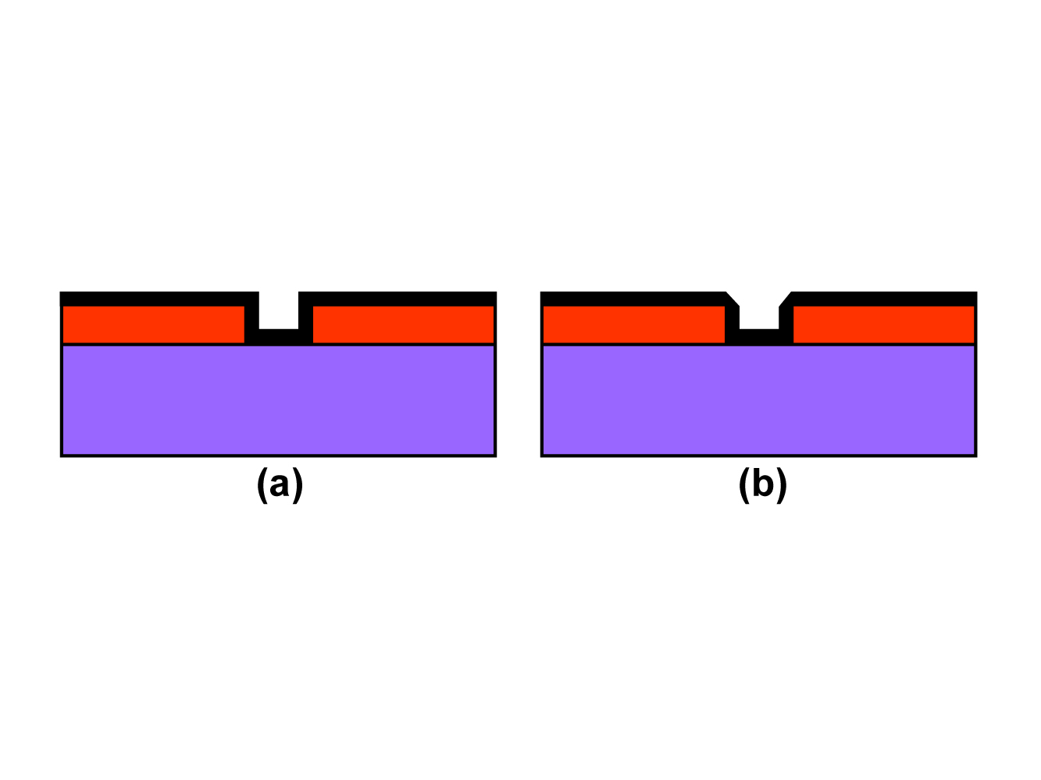
Conformal Coverage
Good Conformal Coverage
Poor Conformal Coverage
From MATEC Module 45
Notes:
Tall, narrow features, as are often required in trench capacitors used in memory circuits or in gratings or filters in MEMS devices require uniform coatings be deposited. In the figure at the left, goodconformal coverage is shown as the black deposition layer is evenly placed on the sidewalls. On the left, the edges are beveled, which may comprimise the function of the structure. In addition (not shown in this view), the deposition process must be able to produce fine, non-directional layer building, or the result may be plugged or filled in features or voids in filled structures. The need for conformality and step coverage can, in some cases, restrict or define the process used for the deposition.

Slide 8
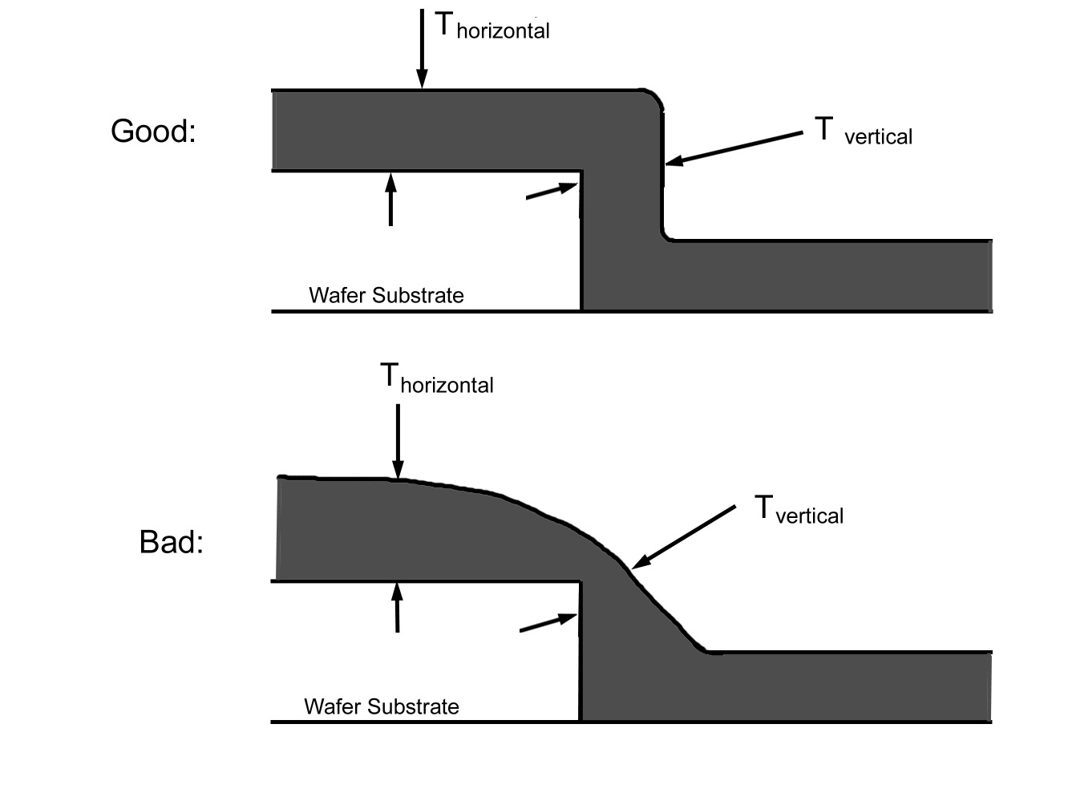
Step Coverage
From MATEC Module 45
Notes:
In this diagram, an abrupt step in a feature is shown. Good step coverage keeps the thickness of the deposition constant even when the feature height changes. Again, subsequent etching of the layer could remove too much from the edge. Film stress on the deposition could result in cracking in a thin section.

Slide 9
Physical Deposition Processes
Sputtering
  Plasma is created by RF or HV DC source
  Inert gas such as Ar is used in a low pressure environment
  Free electrons strike Ar atoms, causing positive ions to be formed
  Negatively charged target material attracts ions
  Ions dislodge particles that are deposited
Notes:
In the sputtering process, a target material of the species that is desired for deposition is negatively charged and placed in a low pressure environment. Argon or another noble gas is injected into the low pressure chamber and, through use of RF energy or high voltage DC, a plasma is created in the chamber by free electrons striking the argon atoms and ionizing them. The ions are attracted to the negatively charged target and are of sufficient energy to overcome the surface binding energy of the target, dislodging atoms of the target which are deposited on the wafer in the chamber.

Slide 10
1. What are the two main types of deposition processes?
Physical and Chemical Deposition
2. What are commonly used metals for deposition?
Aluminum, tungsten, and copper
3. What does conformality of a deposition refer to?
The ability of the deposition to follow surface contours evenly

Slide 11
Evaporative Deposition
Utilizes the principle of vapor pressure
  Metallic species are melted in a low pressure environment
  Higher vapor pressure metals evaporate first
  Deposition of the vapor on the surface occurs
  A low temperature process on the substrate
  Alternatives include laser ablation
    Laser strikes a target, causing local melting
Notes:
Evaporative deposition results when the vapor pressure of a liquid exceeds the chamber pressure. In the atmosphere, we observe this with water on a very slow basis. If the pressure in the chamber is decreased, more evaporation occurs. The process requires melting of the metallic species to be deposited in a crucible.

Slide 12
Evaporative Deposition (2)
Advantages
  Uniformly covers substrate
  Simple process without chemicals or gases
Disadvantages
  Alloys are difficult to deposit
    Different metals have different vapor pressures
  High aspect ratio features are difficult to cover
    Trajectory of evaporated particles tends to be vertical, which may not pattern sidewalls evenly
Notes:
Evaporative deposition has the advantage that it does not require any gases or other chemicals for operation and the evaporative coatings tend to be evenly deposited on flat surfaces. However, there are some disadvantages of evaporative deposition. Since the process depends on vapor pressure, low vapor pressure species will require a very high vacuum environment. In addition, alloy metals tend to be difficult to deposit as different metals have different vapor pressures. The lowest vapor pressure component of the alloy will be deposited first. In addition, the deposition pattern, although uniform, tends to be somewhat straight line. High aspect ratio features such as sidewalls will not be evenly deposited. Sputtering may be a better choice for some of these features. Evaporative depositions are still widely used for optical coatings and other surface processes.

Slide 13
1. Which physical deposition process uses plasma?
Sputtering
2. What is an advantage of sputtering?
Low temperature process, good conformal coating
3. What is a disadvantage of evaporative deposition?
Difficult to deposit alloys, difficult to get good high aspect ratio feature deposition

Slide 14
Spin On Coating
A Physical Deposition Process
  Similar to photoresist spin-on
  Si-based liquid is applied
  Coating is baked on to remove volatile liquid
Used to planarize or flatten wafer surface
  Can be patterned and etched for contacts
Adds steps to process
Alternatives – Chemical Mechanical Polish
Notes:
When metallic depositions are applied to areas with varying height, it is sometimes difficult to attain good conformal and step coverage. A “leveling” layer that planarizes the wafer can be applied through physical means with a spin on coating. Since this coating isolates the metal from the surface that it was intended to connect, subsequent lithography, patterning and etching steps and conductive “plugs” are used to make contact with these regions and the metallic coating that follows. In some cases, it is possible to remove some of the upper layer through a chemical mechanical polishing step. This physically and chemically abrades the surface of the wafer, flattening the surface. In some cases, this is not an acceptable alternative since it can actually remove features.

Slide 15
Chemical Deposition Processes
Wet or Dry?
  Wet processes use liquids and immersion
    Electroplating
    Electroless deposition
    Wet growth of SiO2 insulating layer (water vapor)
  Dry processes use chemical vapors
    Atmospheric Pressure Chemical Vapor Deposition
    Low Pressure Chemical Vapor Deposition
    Plasma Enhanced Chemical Vapor Deposition
Notes:
Chemical deposition processes can be wet or dry depending on the media and method used to deposit the species. Wet processes include electroplating where an anode of the species to be deposited is immersed in an electrolyte solution with the wafer or device to be plated. The wafer is connected to the negative power supply lead and ions from the anode are conducted through the solution and deposited on the surface. Certain metals can be deposited on a surface without the need for electrical energy in electroless deposition. In addition, water vapor can be introduced to an oven with the wafers at high temperature. The water disassociates into hydrogen and oxygen, and the oxygen reacts at the silicon wafer surface to create SiO2. Technically, the water is a vapor when entering, but since it is water, this may be considered a “wet” process.

Slide 16
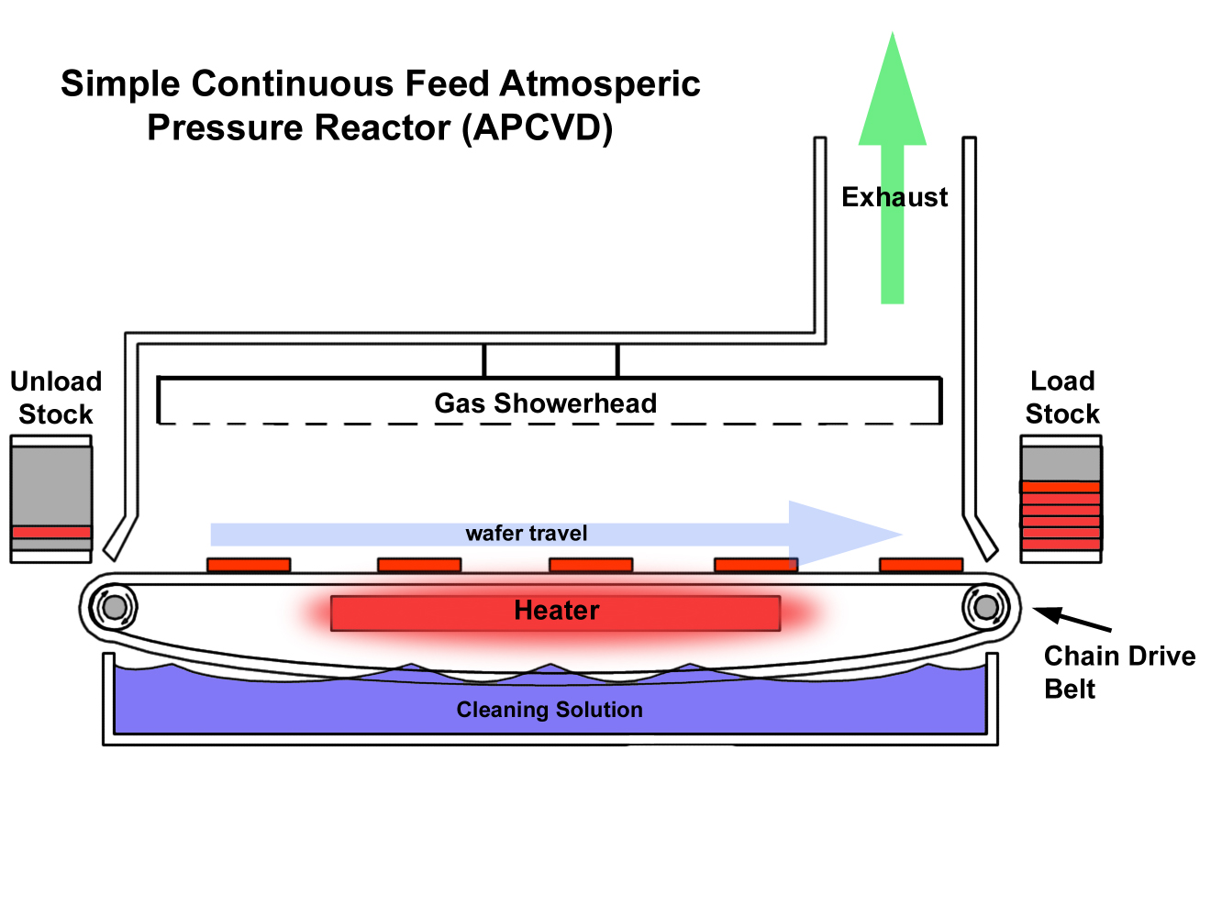
Chemical Deposition Processes
Atmospheric Chemical Vapor Deposition (CVD)
  Wafers are heated
  Chemical gases are introduced
  A temperature dependent deposition rate
  Mass transport limited at higher temperatures
Notes:
The APCVD process heats the wafer surface either through RF induction, direct heating, or IR lamps. Chemical gases are flowed into the chamber, and most APCVD reactors use a moving belt of wafers. The thickness of the deposition depends on the wafer temperature. As temperature goes up, the reaction speeds up, thickening the deposition, but only to the point where the reaction becomes limited by the flow of chemicals to the surface (mass transport limited). APCVD is a relatively simple process that does not require a controlled environment, but it suffers from poor step and conformal coverage and deposition purity. APCVD does find significant usage in the non-emissive coatings used in windows and in certain forms of anti-reflective coatings.

Slide 17
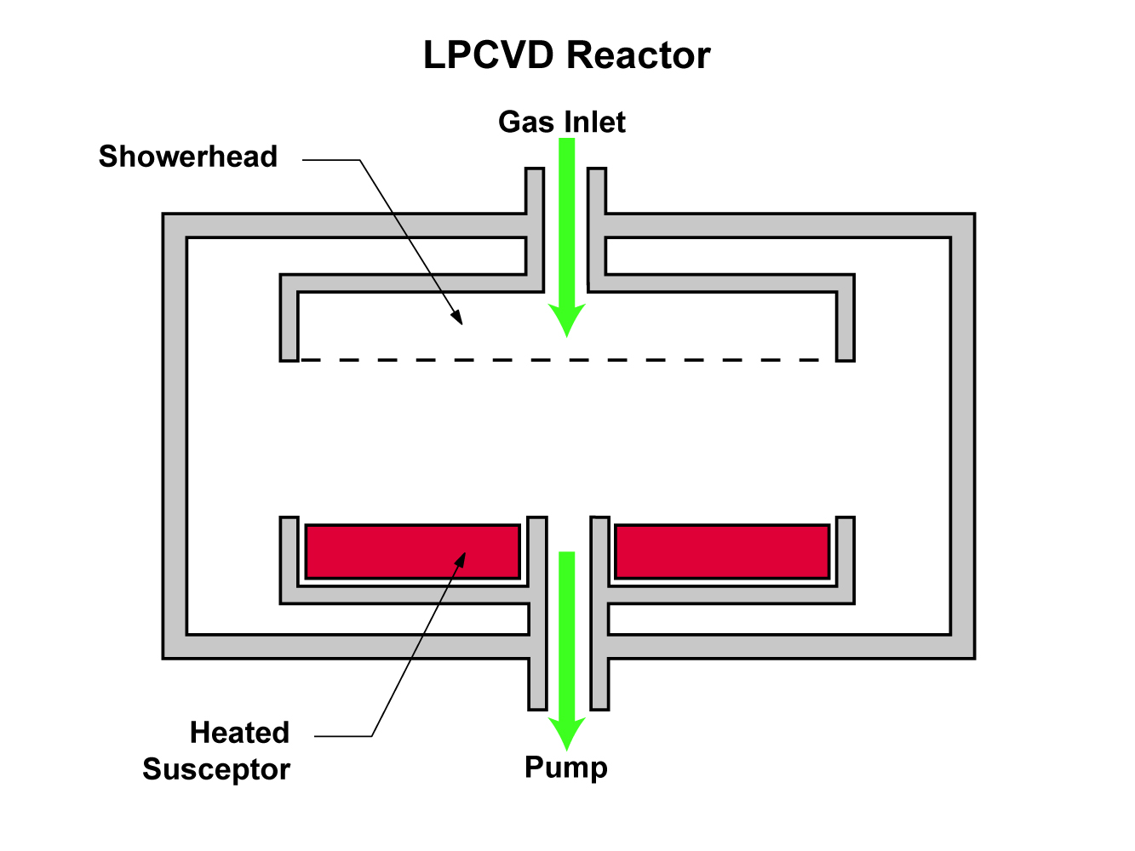
Chemical Deposition Processes
Low Pressure (CVD)
  Surface reaction limited at low pressure
  Chamber may also be heated or unheated
  Low pressure environment increases mean free path
  Better Step Coverage and conformality than APCVD
From MATEC Module 54
Notes:
The LPCVD process heats the wafer surface and, in some cases, the entire reaction chamber (hot wall .vs. cold wall). The reduced pressure environment increases the mean free path of the reactant gas molecules, decreasing the number of collisions between molecules, making this a more efficient process. In addition, the step coverage and conformality of LPCVD are very good. The deposition rate is low, however, and there are limitations in using this process at certain points in manufacturing since it is performed at temperatures that may exceed the melting points of some metals.

Slide 18
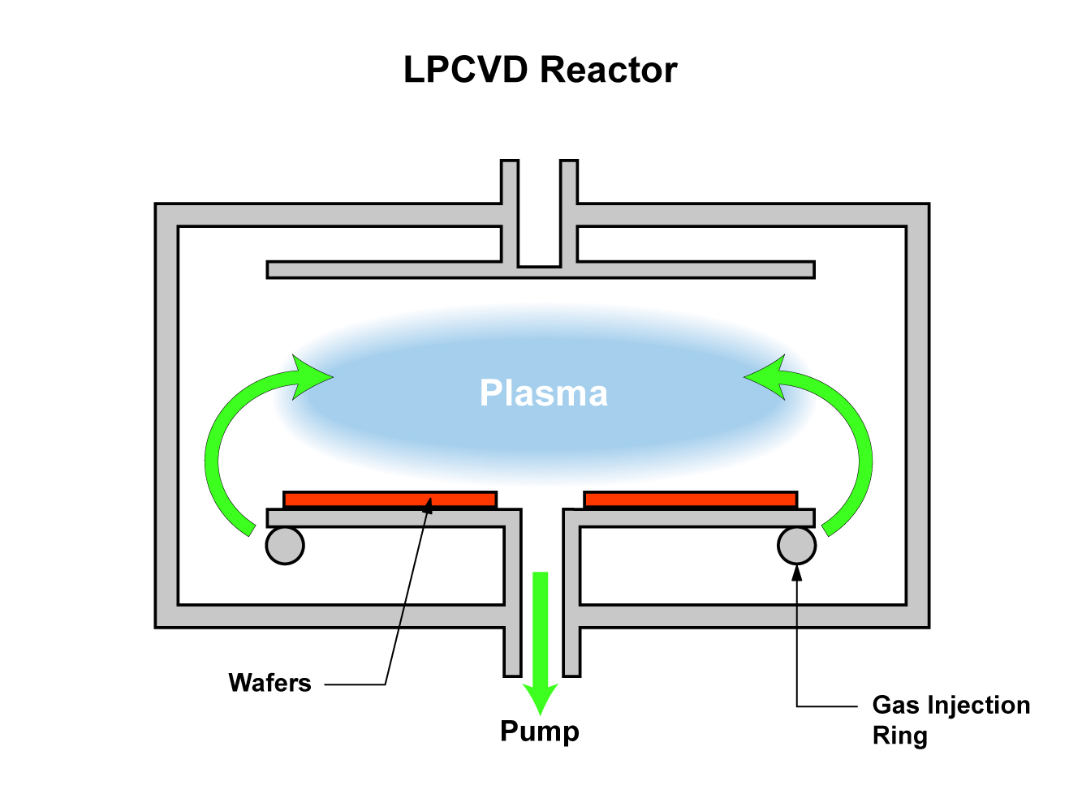
Chemical Deposition Processes
Plasma Enhanced Low Pressure (CVD)
  Lower Temperature Process due to Plasma Enhancement
  Dissociation of precursor gas molecules (Homogeneous reactions)
  Ions bombard surface making it more reactive
  Higher rates of deposition are possible than with LPCVD
From MATEC Module 54
Notes:
The PECVD process uses plasma to disassociate the precursor gas prior to contact with the wafer surface. A large number of ions strike the negatively charged wafer surface. No external heating is supplied so this is a lower temperature process). The deposition rate of PECVD is much higher than that possible with LPCVD. PECVD is the pre-eminent process in use in many fabrication facilities for all these reasons. It is, however, possible to damage the substrate when high energy ions strike the wafer surface, and an unintentional “etch” can occur.

Slide 19
Chemical Deposition Processes
Anti-reflective coatings
  Reflection from shiny layers below photoresist causes blurred features
  Utilize thin film deposition to create coatings that have λ/2 thickness at the exposure lamp wavelength
  This results in destructive interference canceling reflection in the photoresist layer
  Finer lithography is possible
Notes:
Deposited thin films need not be part of the structure of a device. In this example, an anti-reflection coating of Titanium nitride is used to reduce the reflections from metallic or shiny polysilicon layers that are below. A precise thickness of this nitride layer results in destructive interference to reflected wavelengths in the photoresist, eliminating an apparent “blurring” of the features that occurs from reflection. The thickness is proportional to the wavelength of the light source.

Slide 20
1. What are the advantages of atmospheric CVD?
Simple equipment requirements and batch processing is possible
2. What is an advantage of low pressure CVD?
Improved purity of deposition and good step coverage
3. What is a principal advantage of plasma enhanced CVD?
It is a lower temperature process than LPCVD

